Slide 2
MuniciPAY is a customizable electronic payment processing system specifically geared toward government entities. It allows for the municipality to offer convenience to its residents while preventing the municipality from paying processing fees associated with card acceptance as the fees are passed onto the cardholder.
Fees for Credit and Debit Cards are 2.65% of the total transaction or a $3.00 minimum.
The fee for ACH transactions is a flat fee of $1.50.

Slide 3
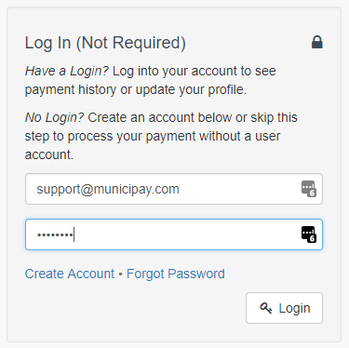
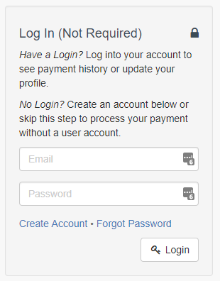
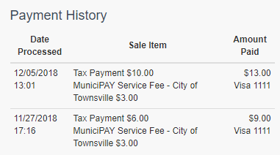
EASE OF USE FOR RESIDENTS Residents can choose to either set up an account or to make payments as a Guest User. When an account is set up, residents will be able to access their payment history through the MuniciPAY system.

Slide 4
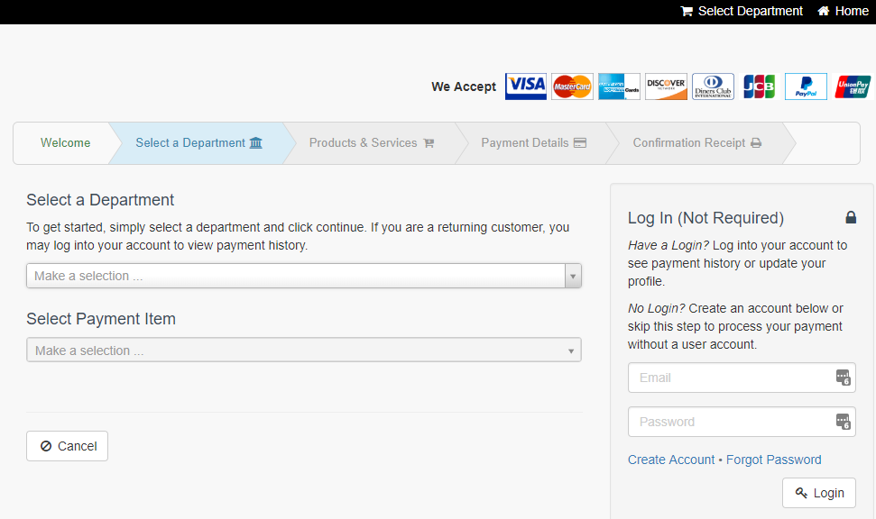
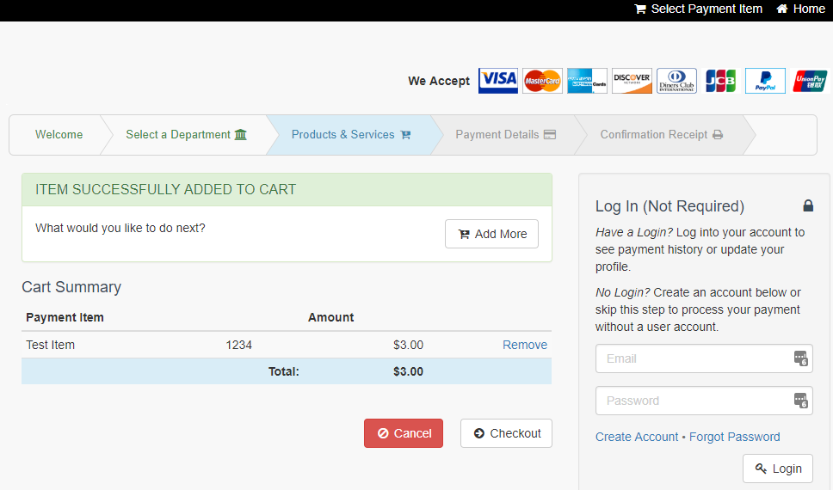
Users can select products by department and add to their carts. They have the option to pay with a credit card, debit card or by ACH transaction.

Slide 5
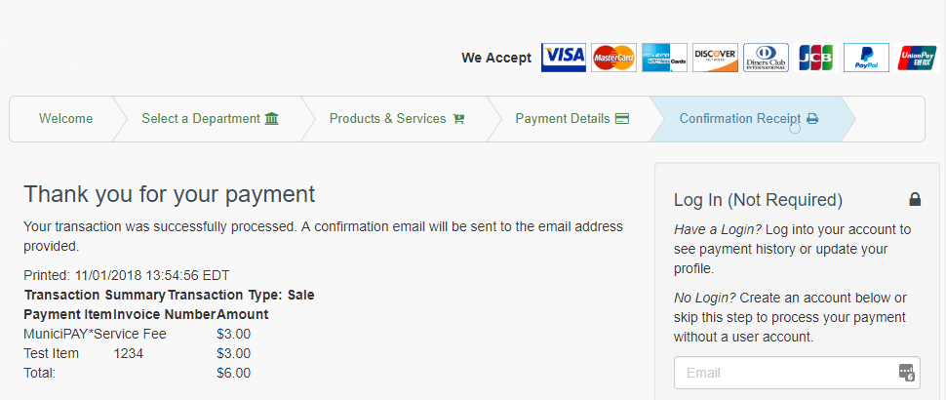
Once a transaction is complete, the user will receive a confirmation on his/her screen as well as a confirmation email.

Slide 6
Easy to use for the Town of Marbletown:
No set-up fees, monthly fees or processing fees for the Town
All payments and transactions are secure through Nationwide Payments, which is a Level II DSS Service Provider, meeting all Payment Application Data Security Standards
Option to have Card Readers for each department. Card Readers have a one-time fee of $185.00
Funds are deposited into the corresponding depository accounts within 2 business days for card transactions and 3 business days for ACH transactions
Detailed Transaction Reporting allows reports to be run by Batch, Department, Item and User
Transaction Search allows for quick searching for Departments to find a specific transaction by name, email, amount or transaction type
Each Department will have its own access to the Department Reporting for ease of management and reconciliation

Slide 7
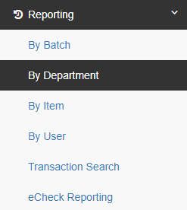
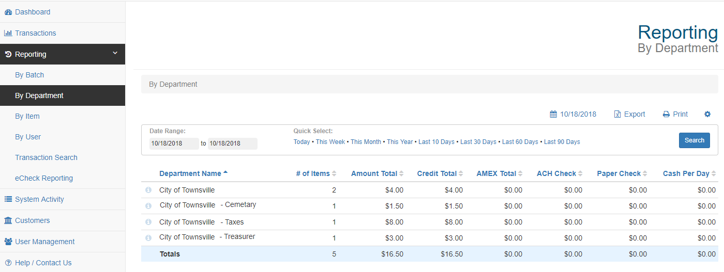

Slide 8
